Slide 1
Evolutionary neurobiology of zooplankton larvae
COS SAB 2025 Gáspár Jékely

Slide 2
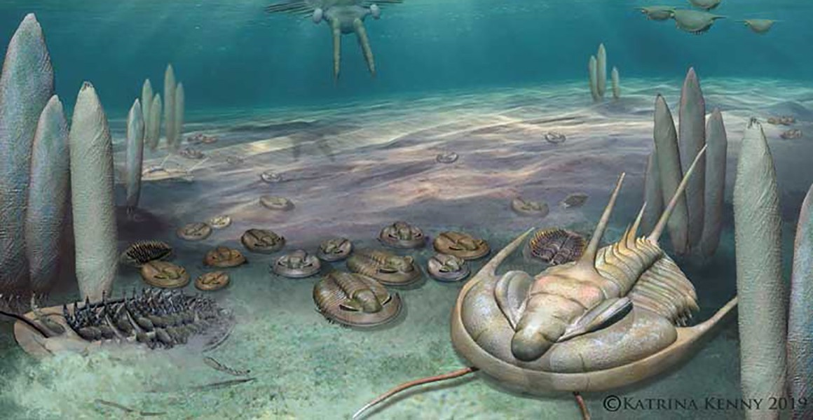
Nervous systems evolved in the sea

Slide 3
National History Museum

Slide 4
Zooplankton behaviour

Slide 6
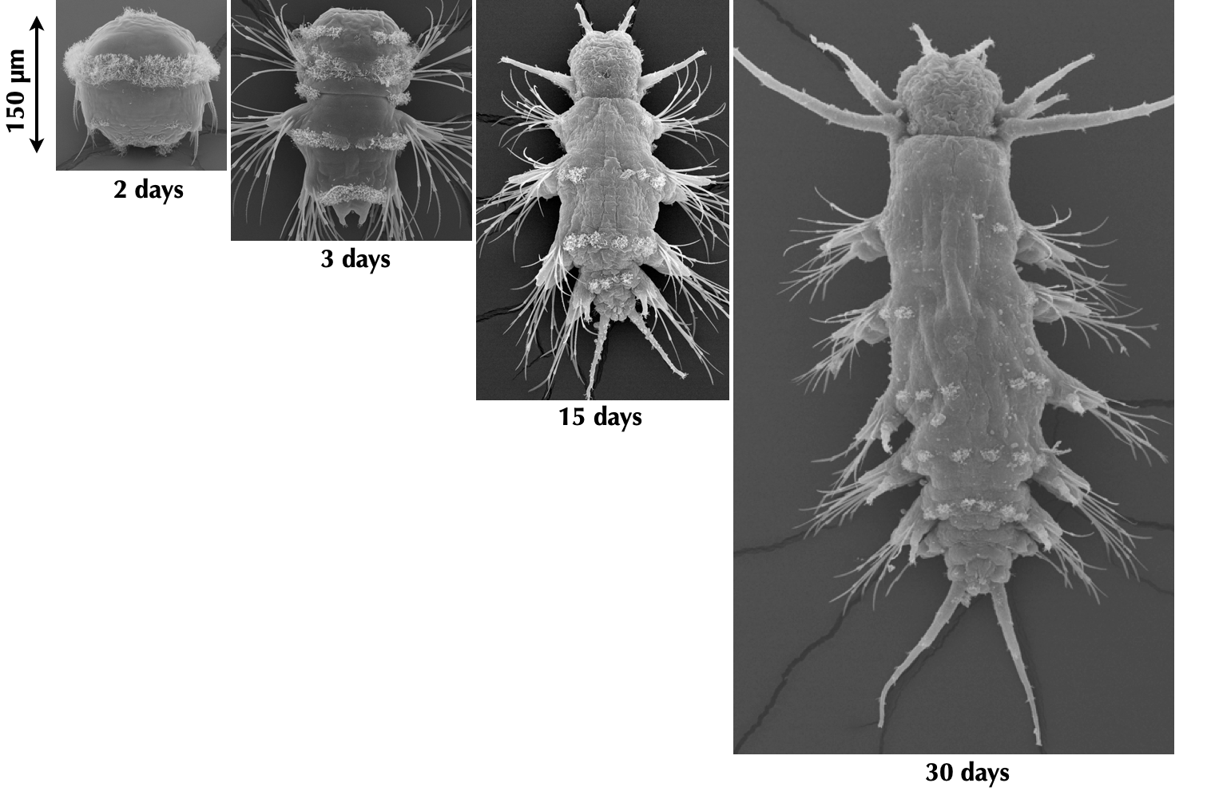
Platynereis dumerilii

Slide 7
breeding culture
microinjection, transgenesis
neuron-specific promoters and antibodies
knock-out lines
neuronal connectome
neuronal activity imaging 😎

Slide 8
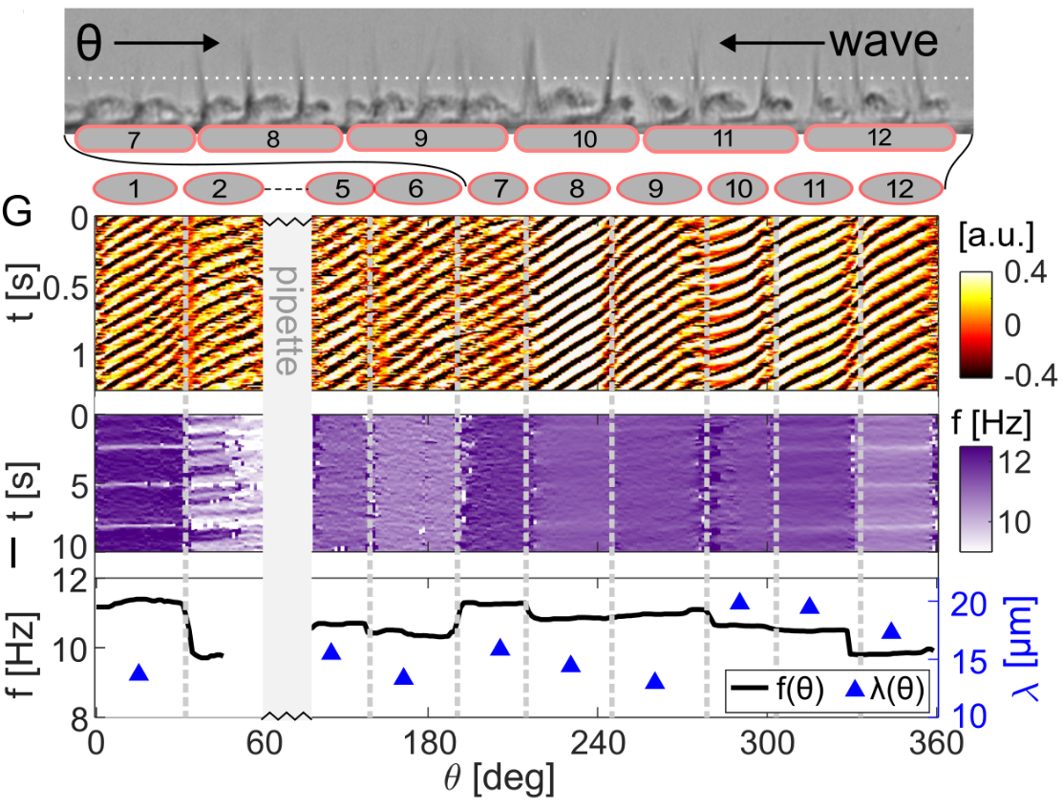
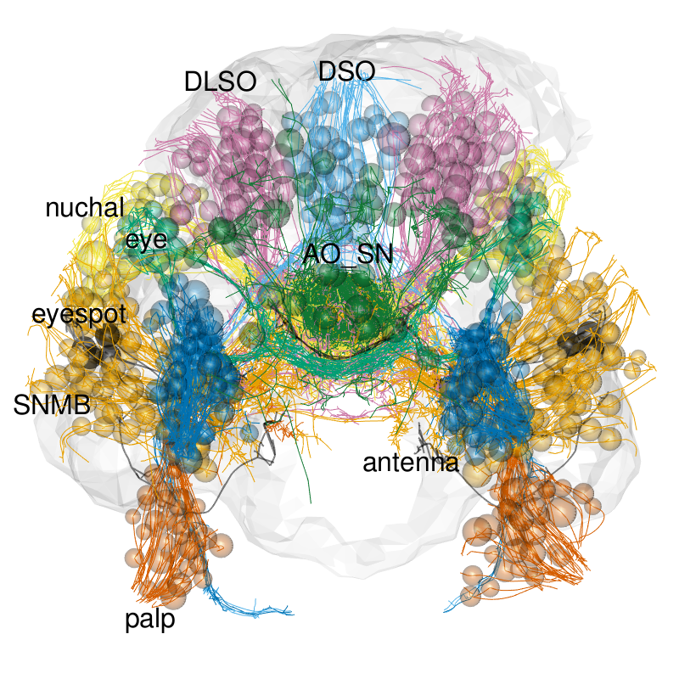
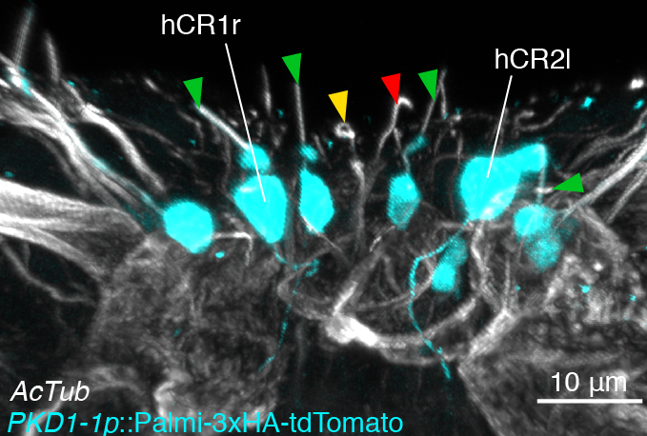
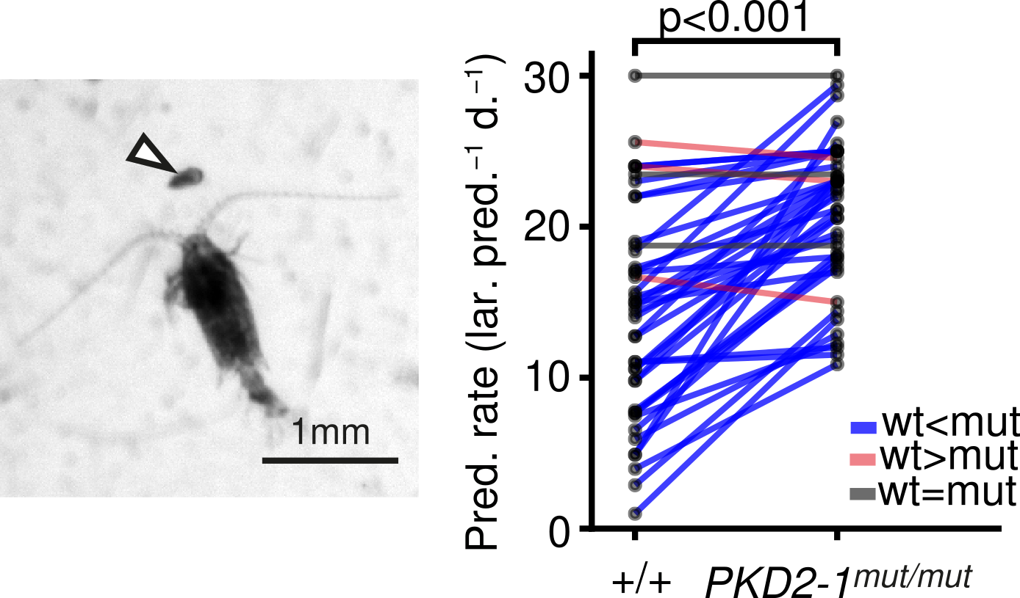
From biophysics to environment
biophysics
genetics
connectomics
environment

Slide 9
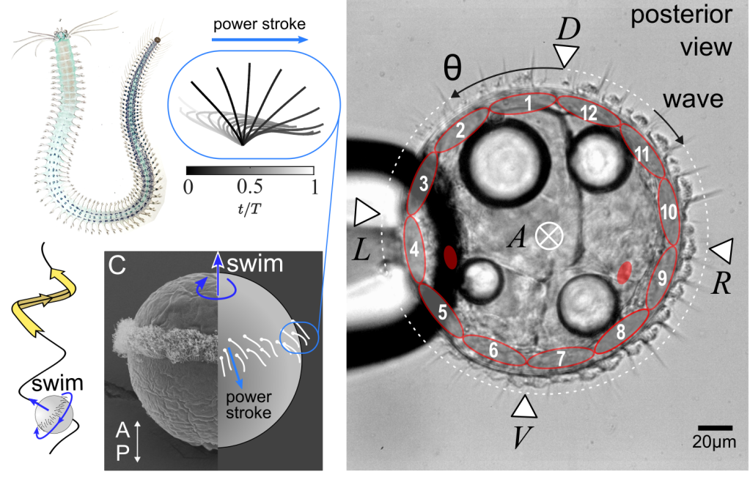
Biophysics of ciliary microswimmers

Slide 10
Poon et al. 2023 Poon et al. 2025

Slide 11
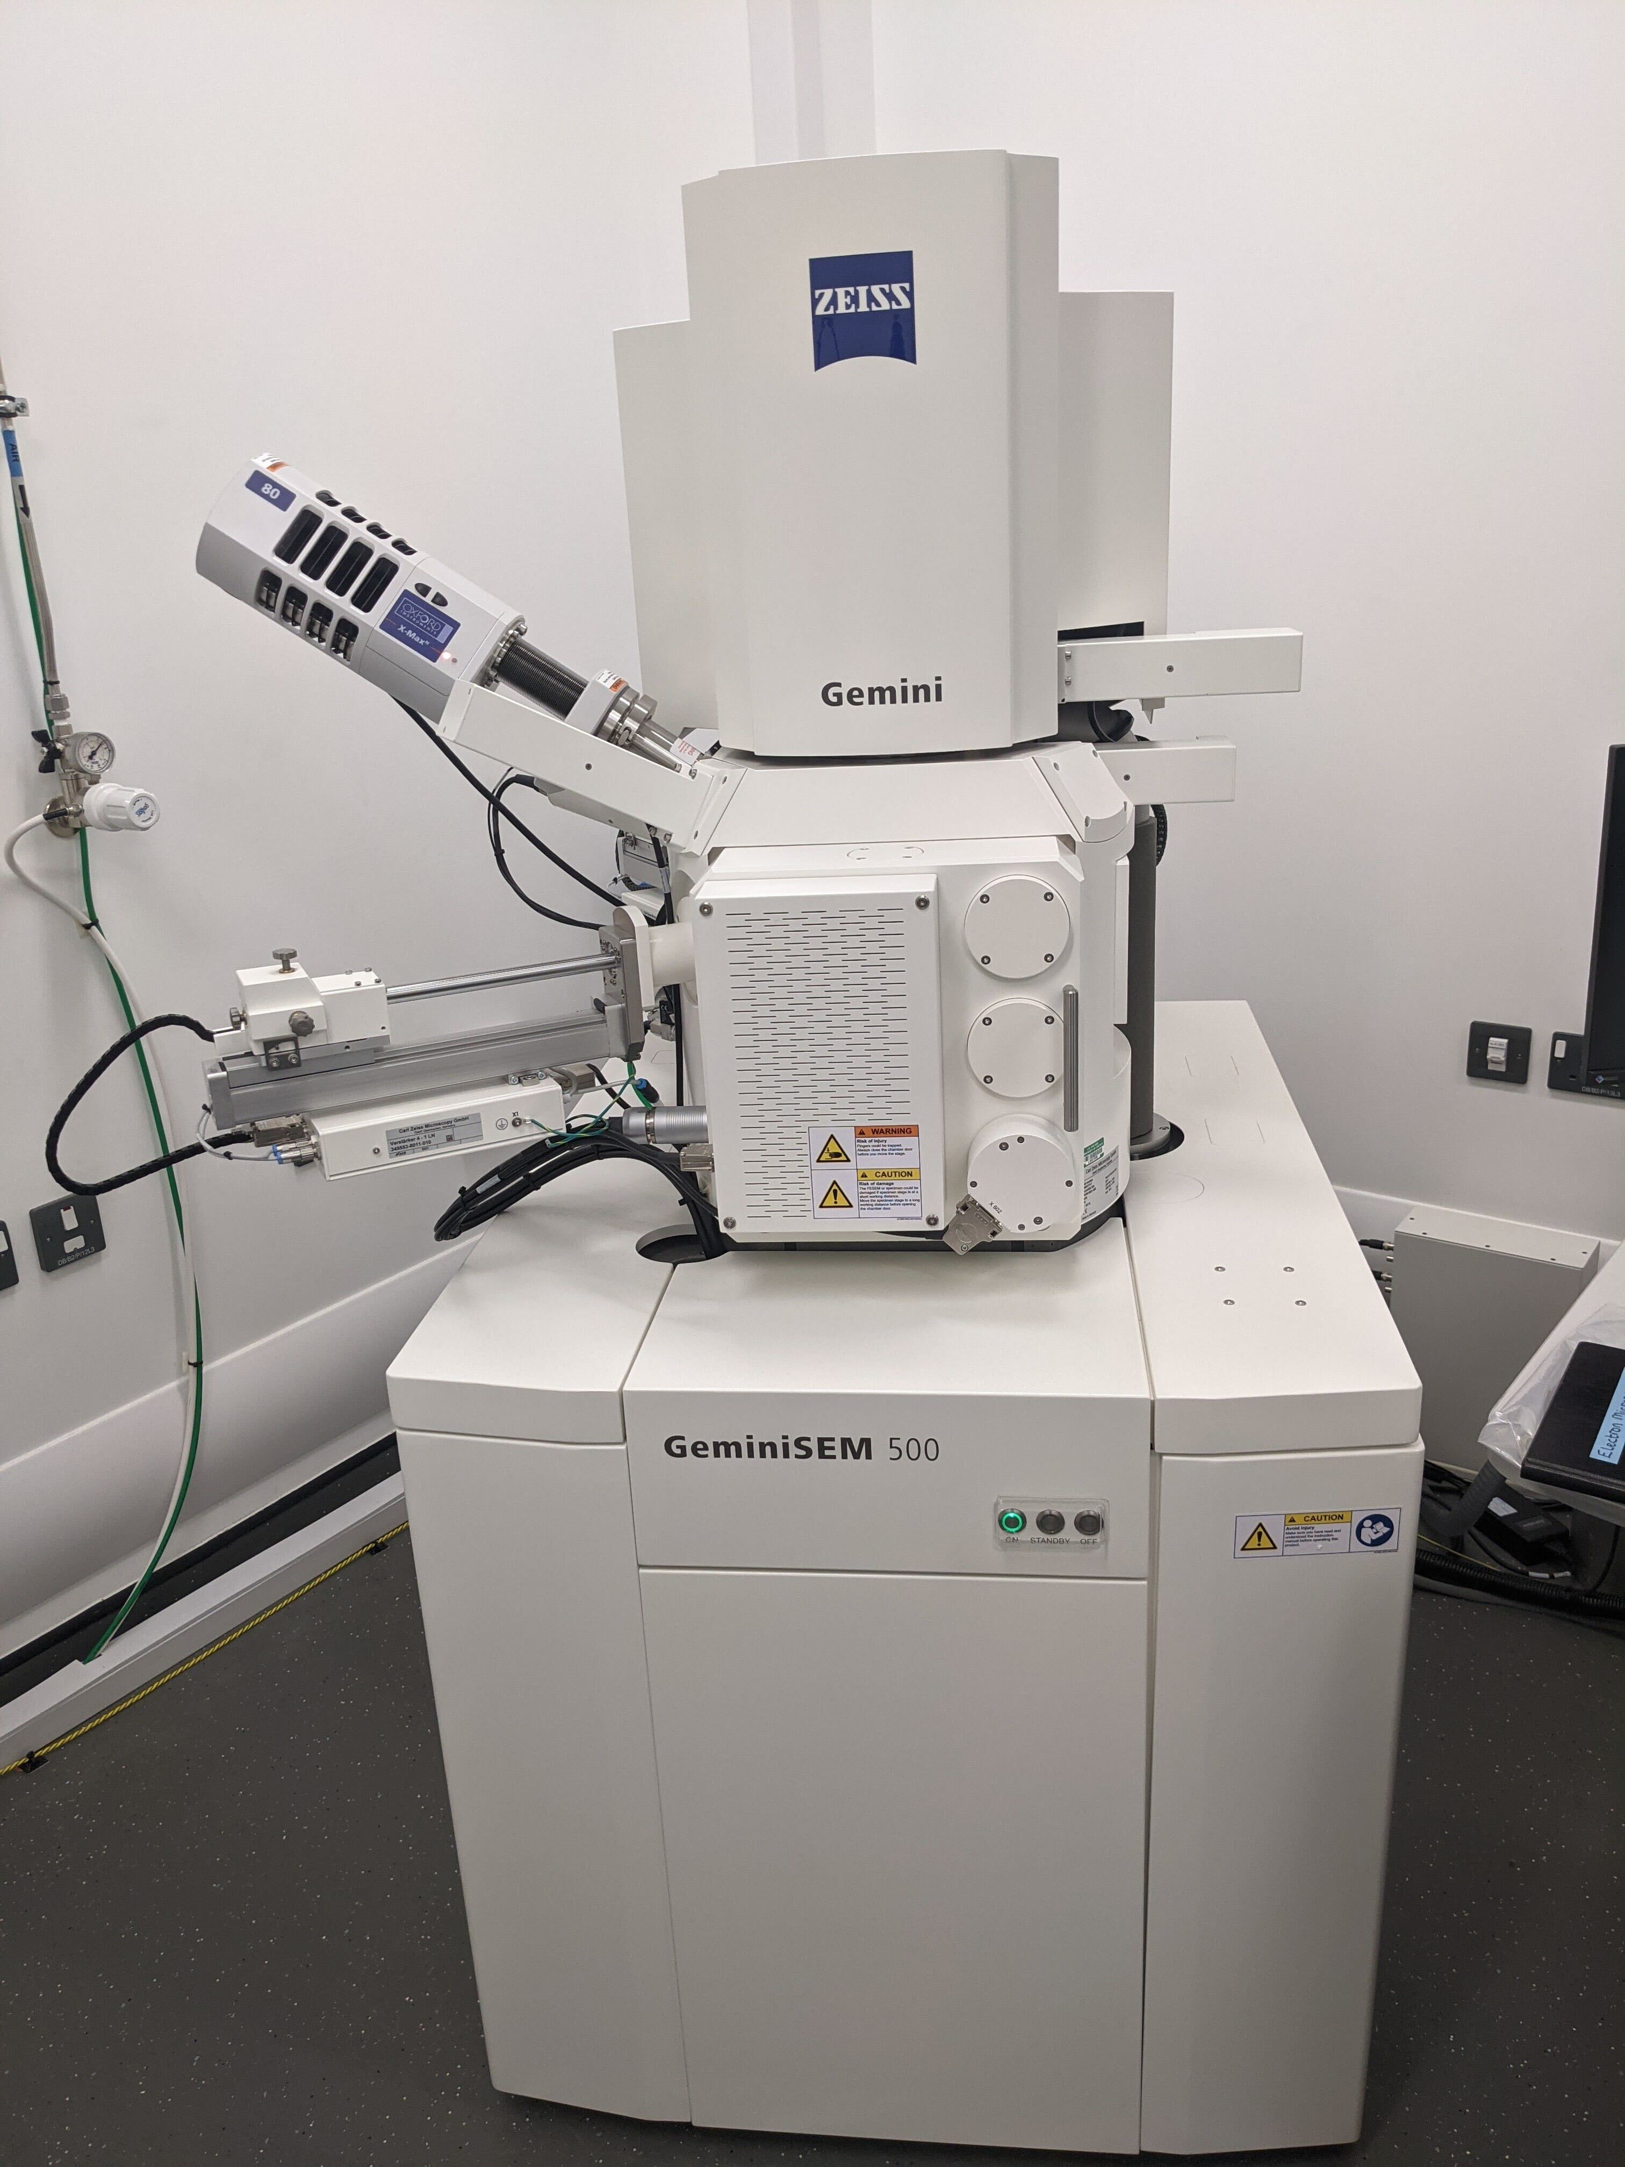
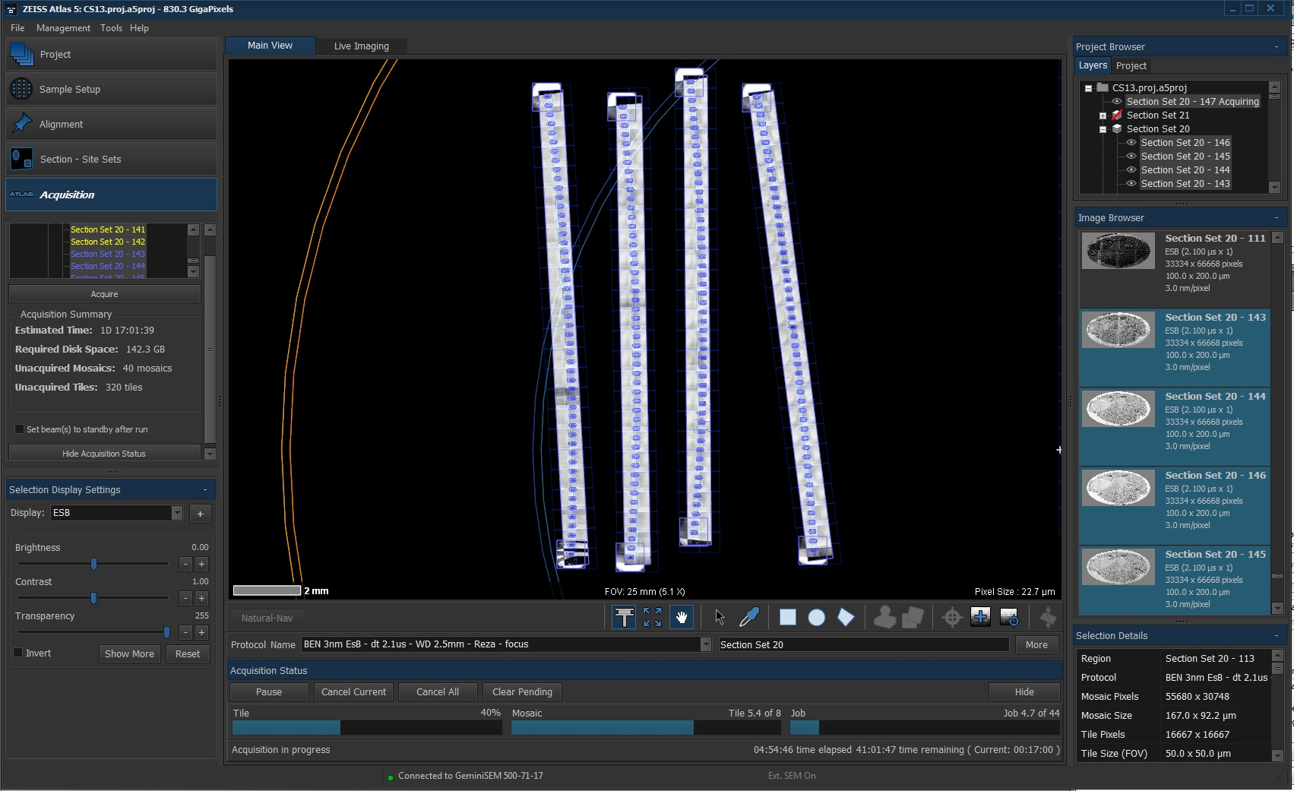
Array tomography for vEM and connectomics

Slide 12
Whole-body connectome of a segmented annelid larva

Slide 13
Verasztó & Jasek et al. (2024)

Slide 14
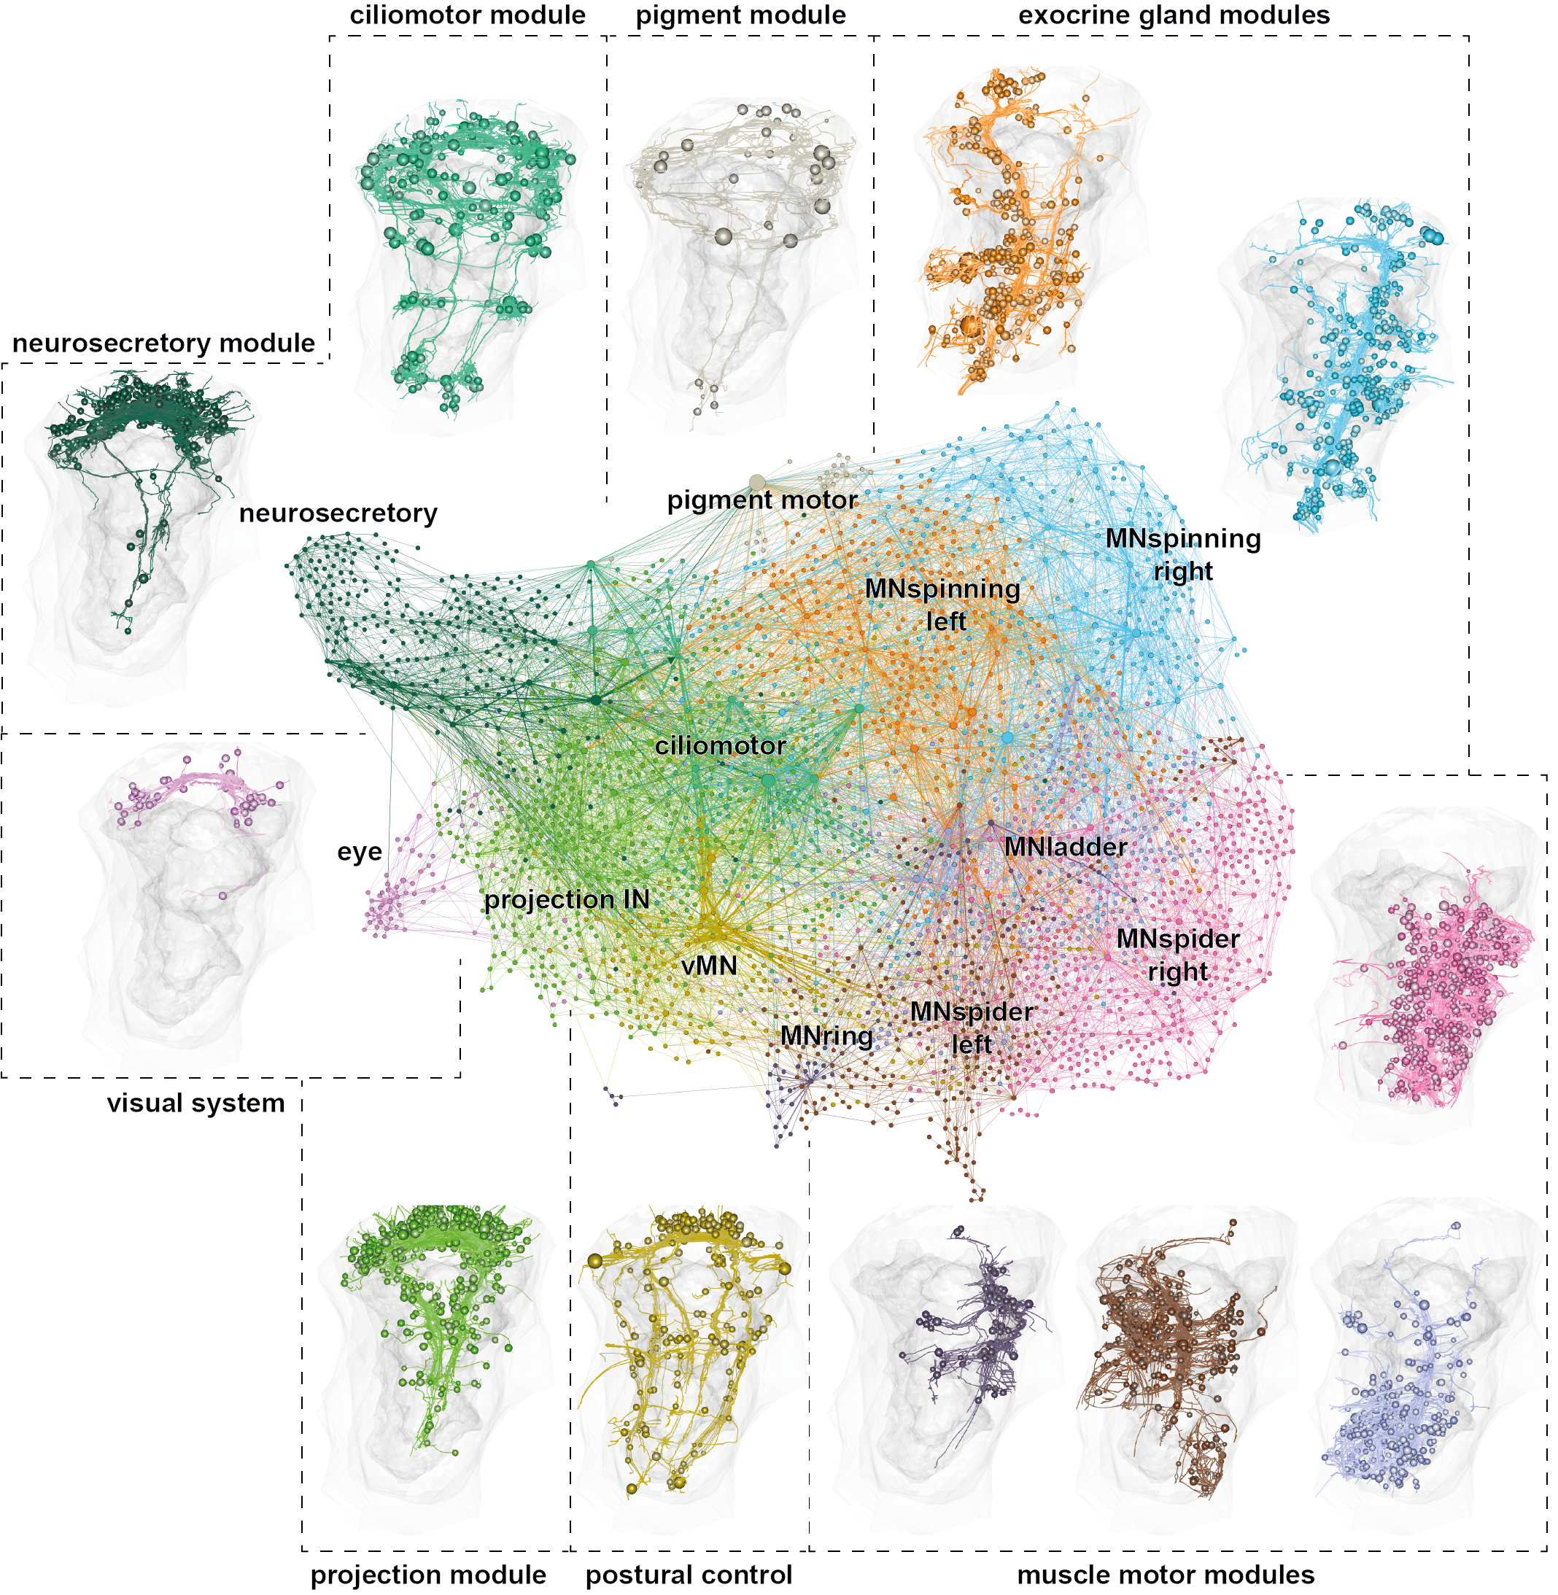

Slide 15
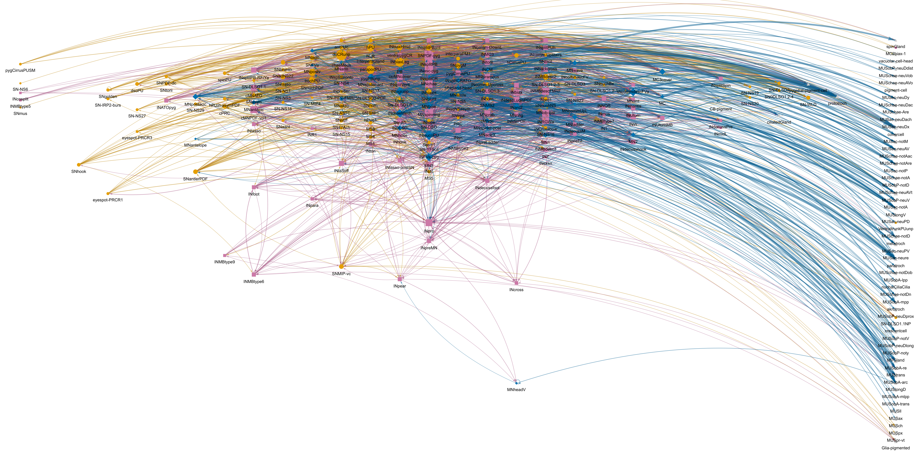
Information flow from sensors to effectors

Slide 16
Verasztó & Jasek et al. (2024)

Slide 17
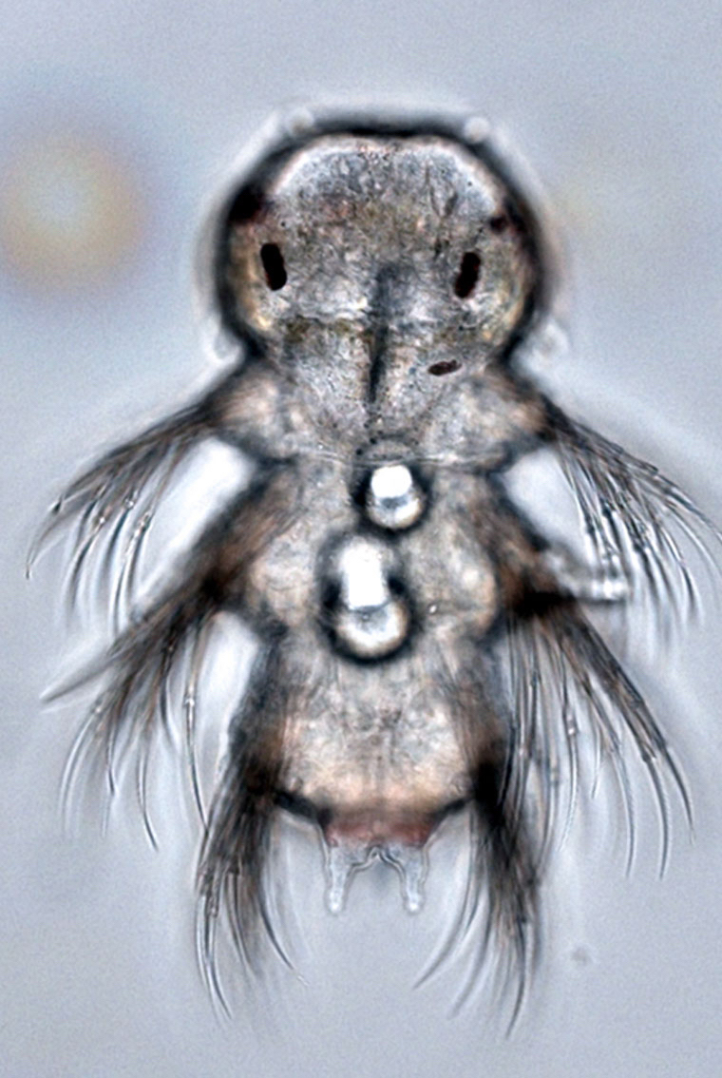
UV response in Platynereis larvae

Slide 18
Verasztó, Gühmann et al. (2018)

Slide 19
Brain ciliary photoreceptors with ramified cilia
Verasztó, Gühmann et al. (2018)

Slide 20
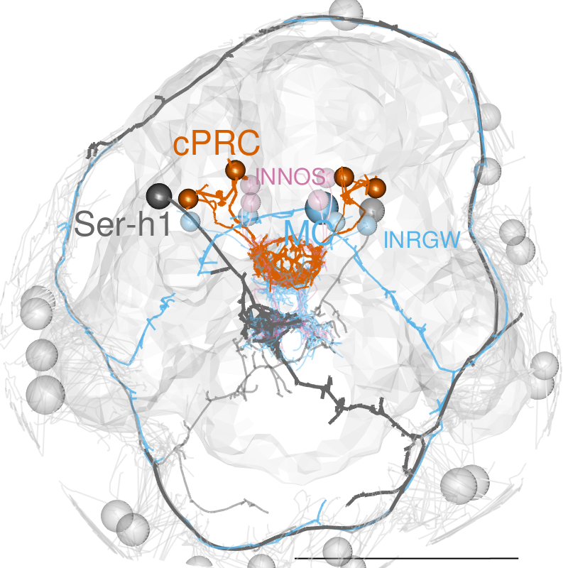
Circuitry of ciliary photoreceptors

Slide 21
Verasztó, Gühmann et al. (2018)

Slide 22
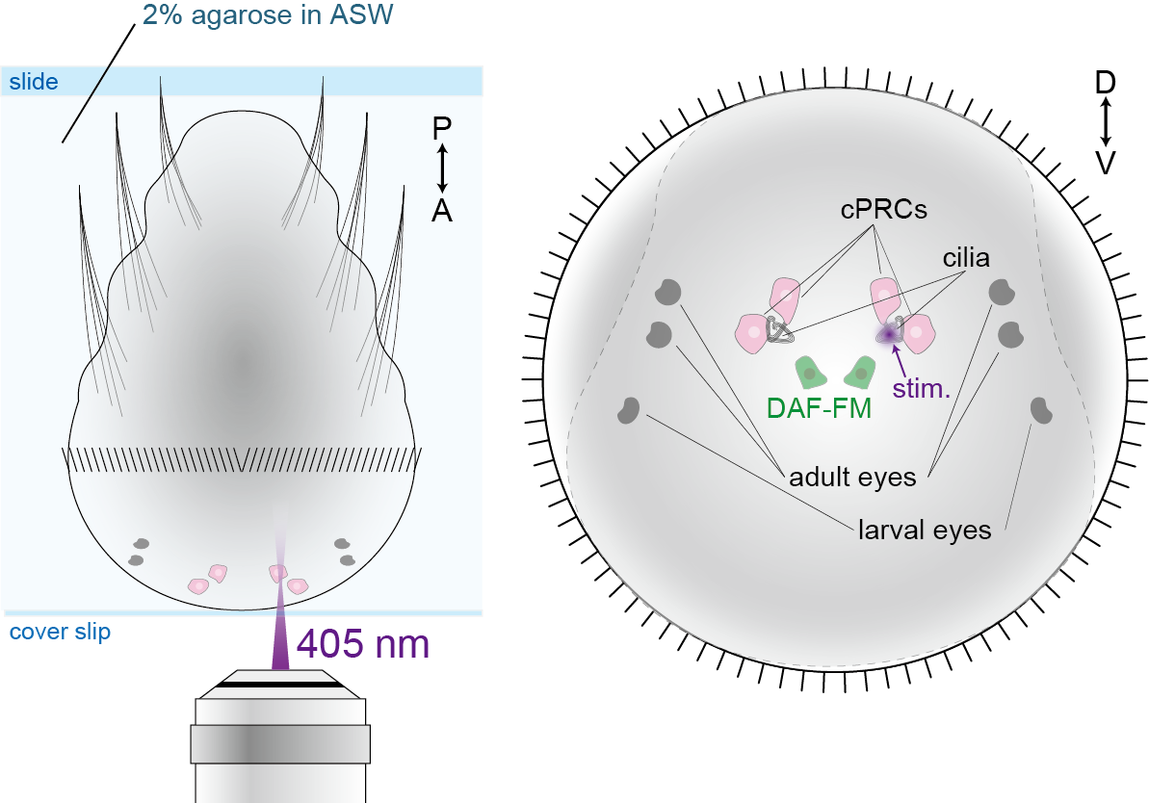
Strong cPRC activation after UV exposure

Slide 23
Jokura et al. 2023

Slide 24
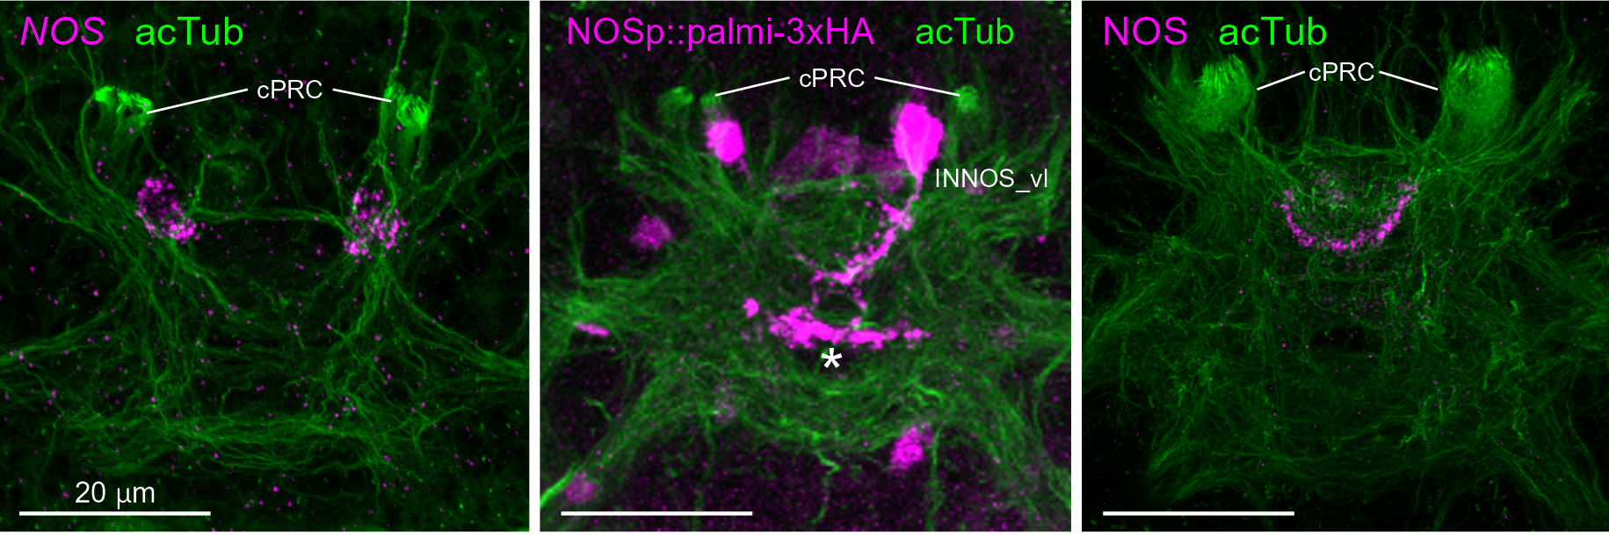
Nitric-oxide synthase in postsynaptic interneurons

Slide 25
Jokura et al. 2023

Slide 26
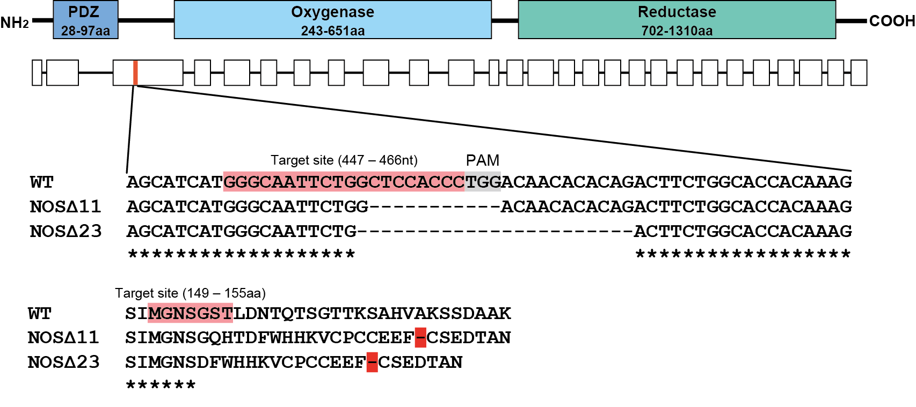
NOS mutants have defective UV response

Slide 27
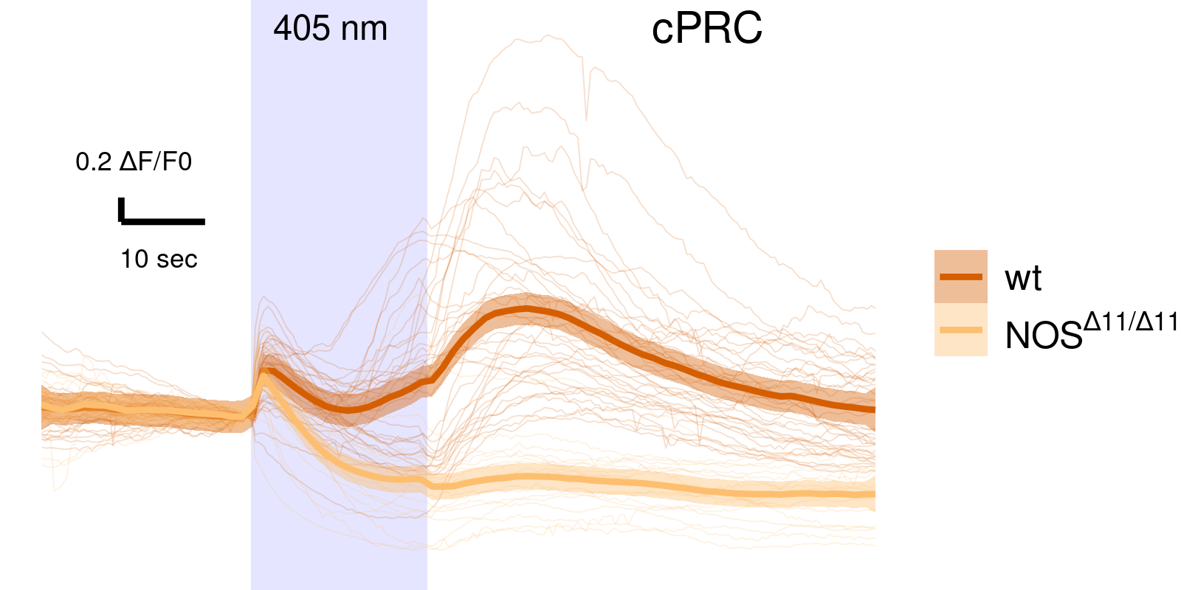

Slide 28
Jokura et al. 2023

Slide 29
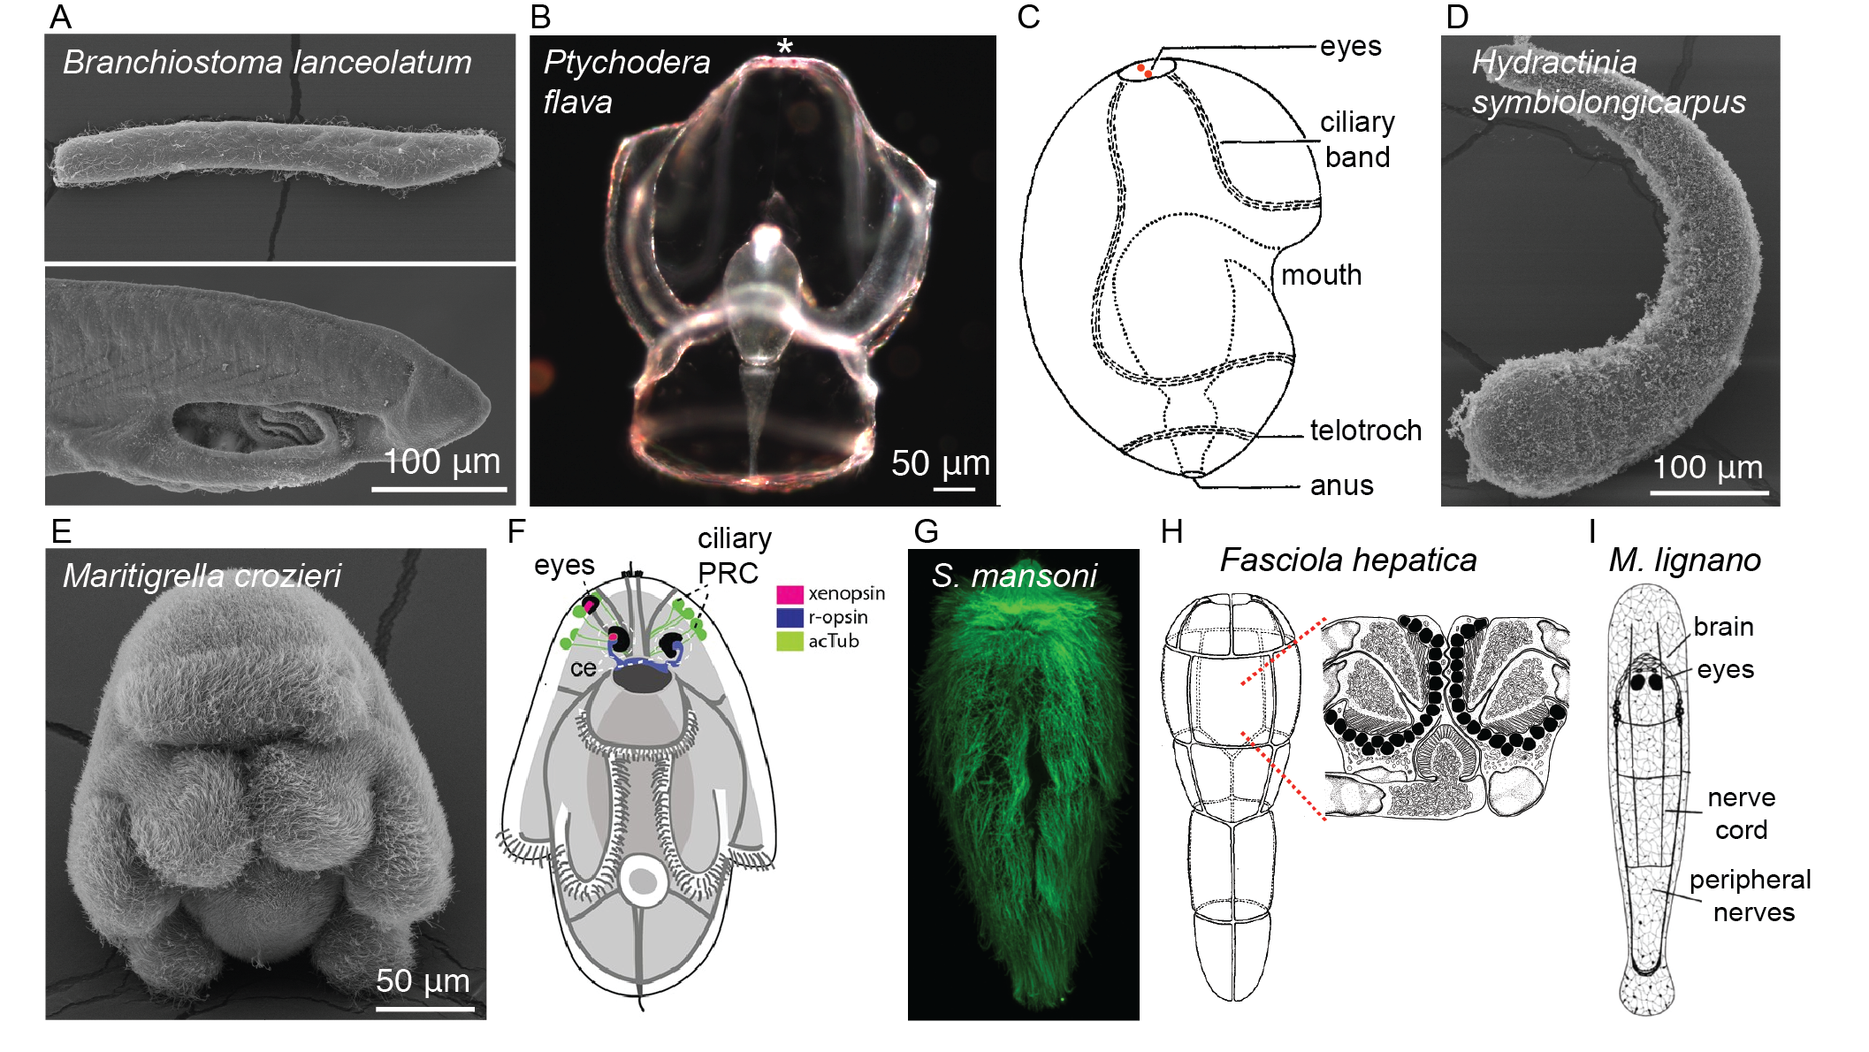
In quest of the origin of eyes

Slide 30
ERC AdG Project - PROTOEYE

Slide 31
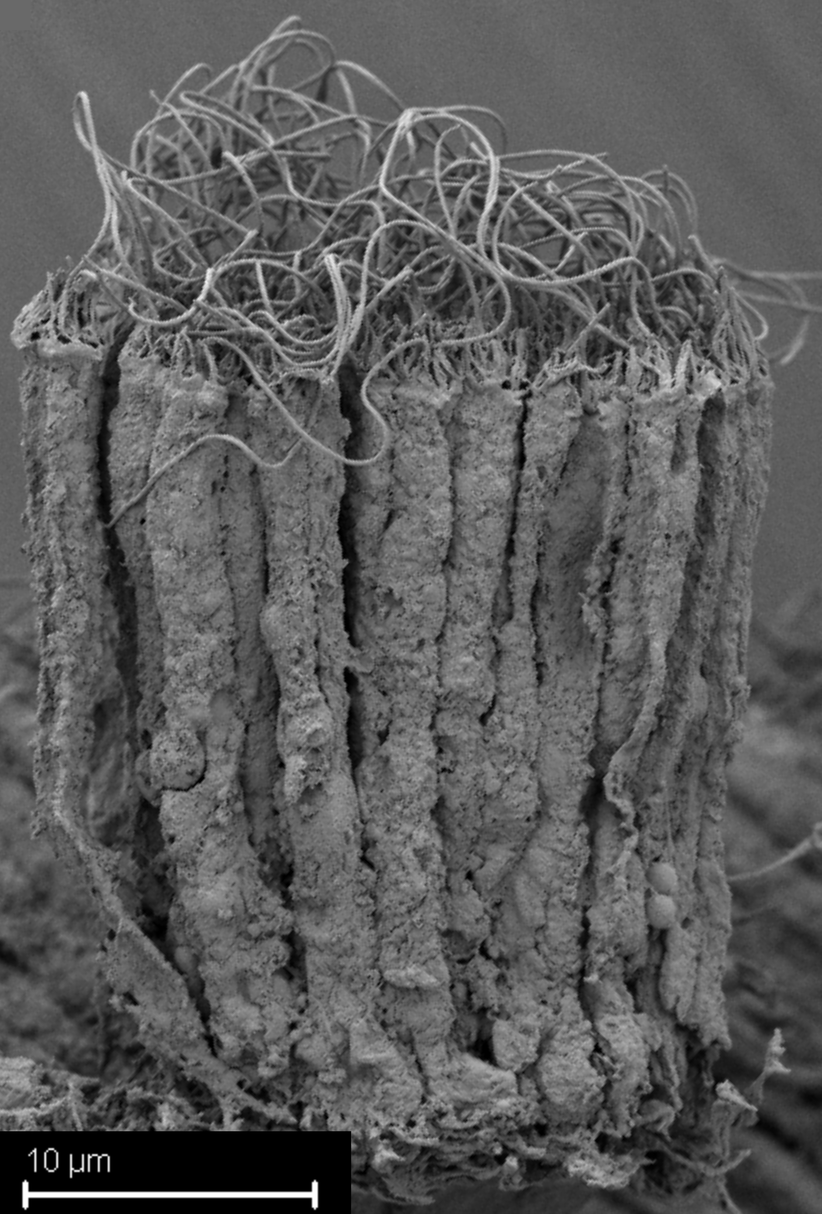
Coral larvae
Hannah Laeverenz

Slide 32
Poon et al. 2023

Slide 33
Coral larval light responses and connectome

Slide 34
Brodrick et al. 2025

Slide 35
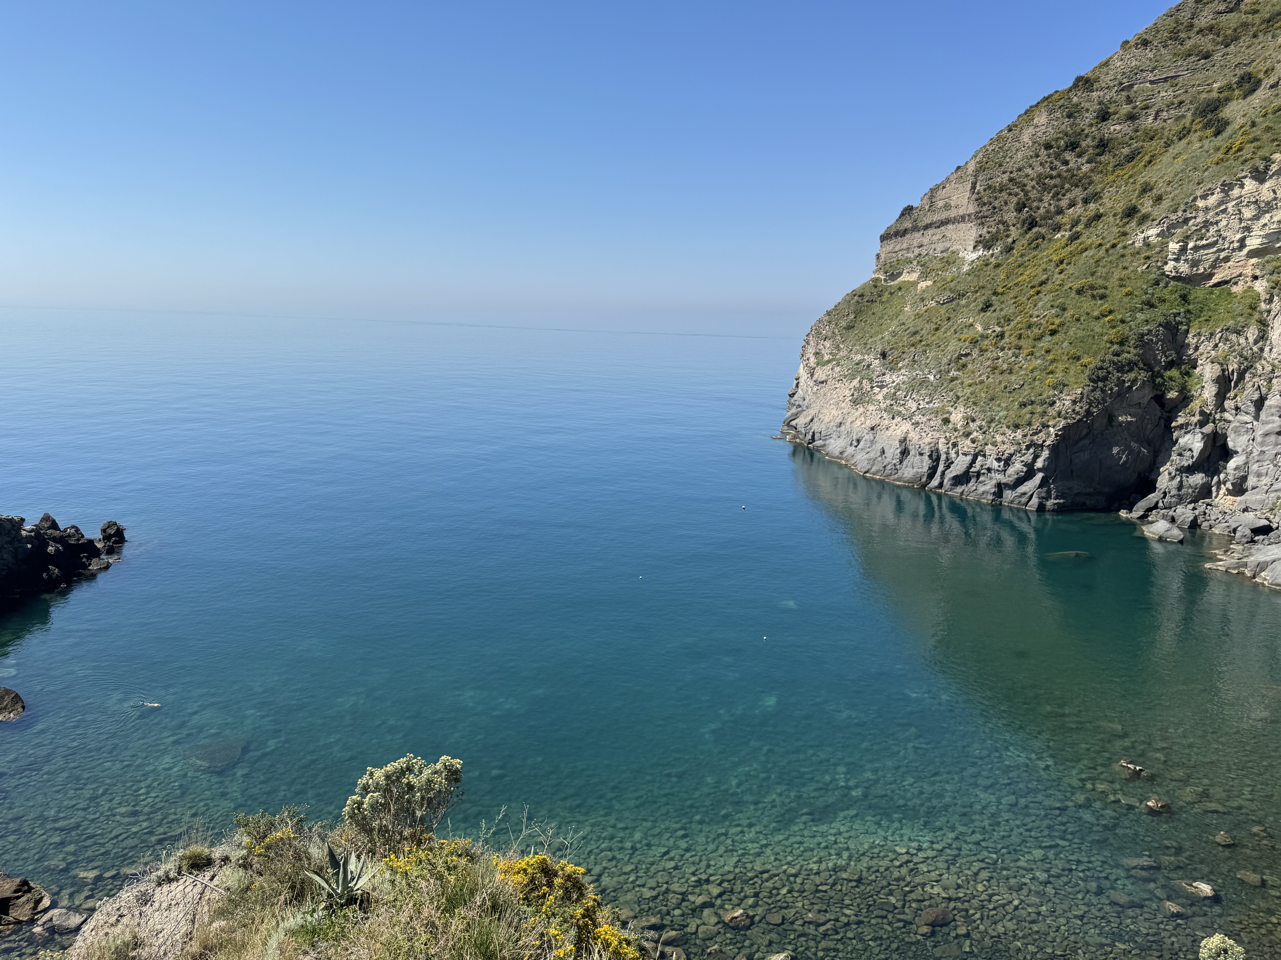
Field trips to explore marine plankton

Slide 36
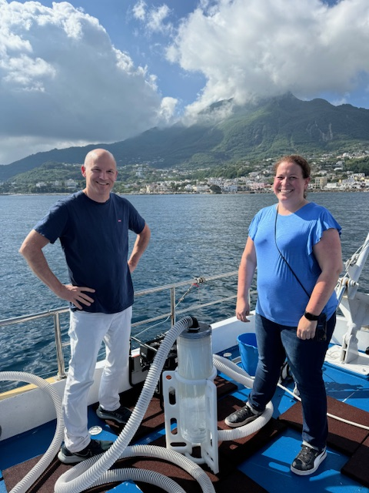

Slide 37
Ischia, Sorgeto, 2024

Slide 38
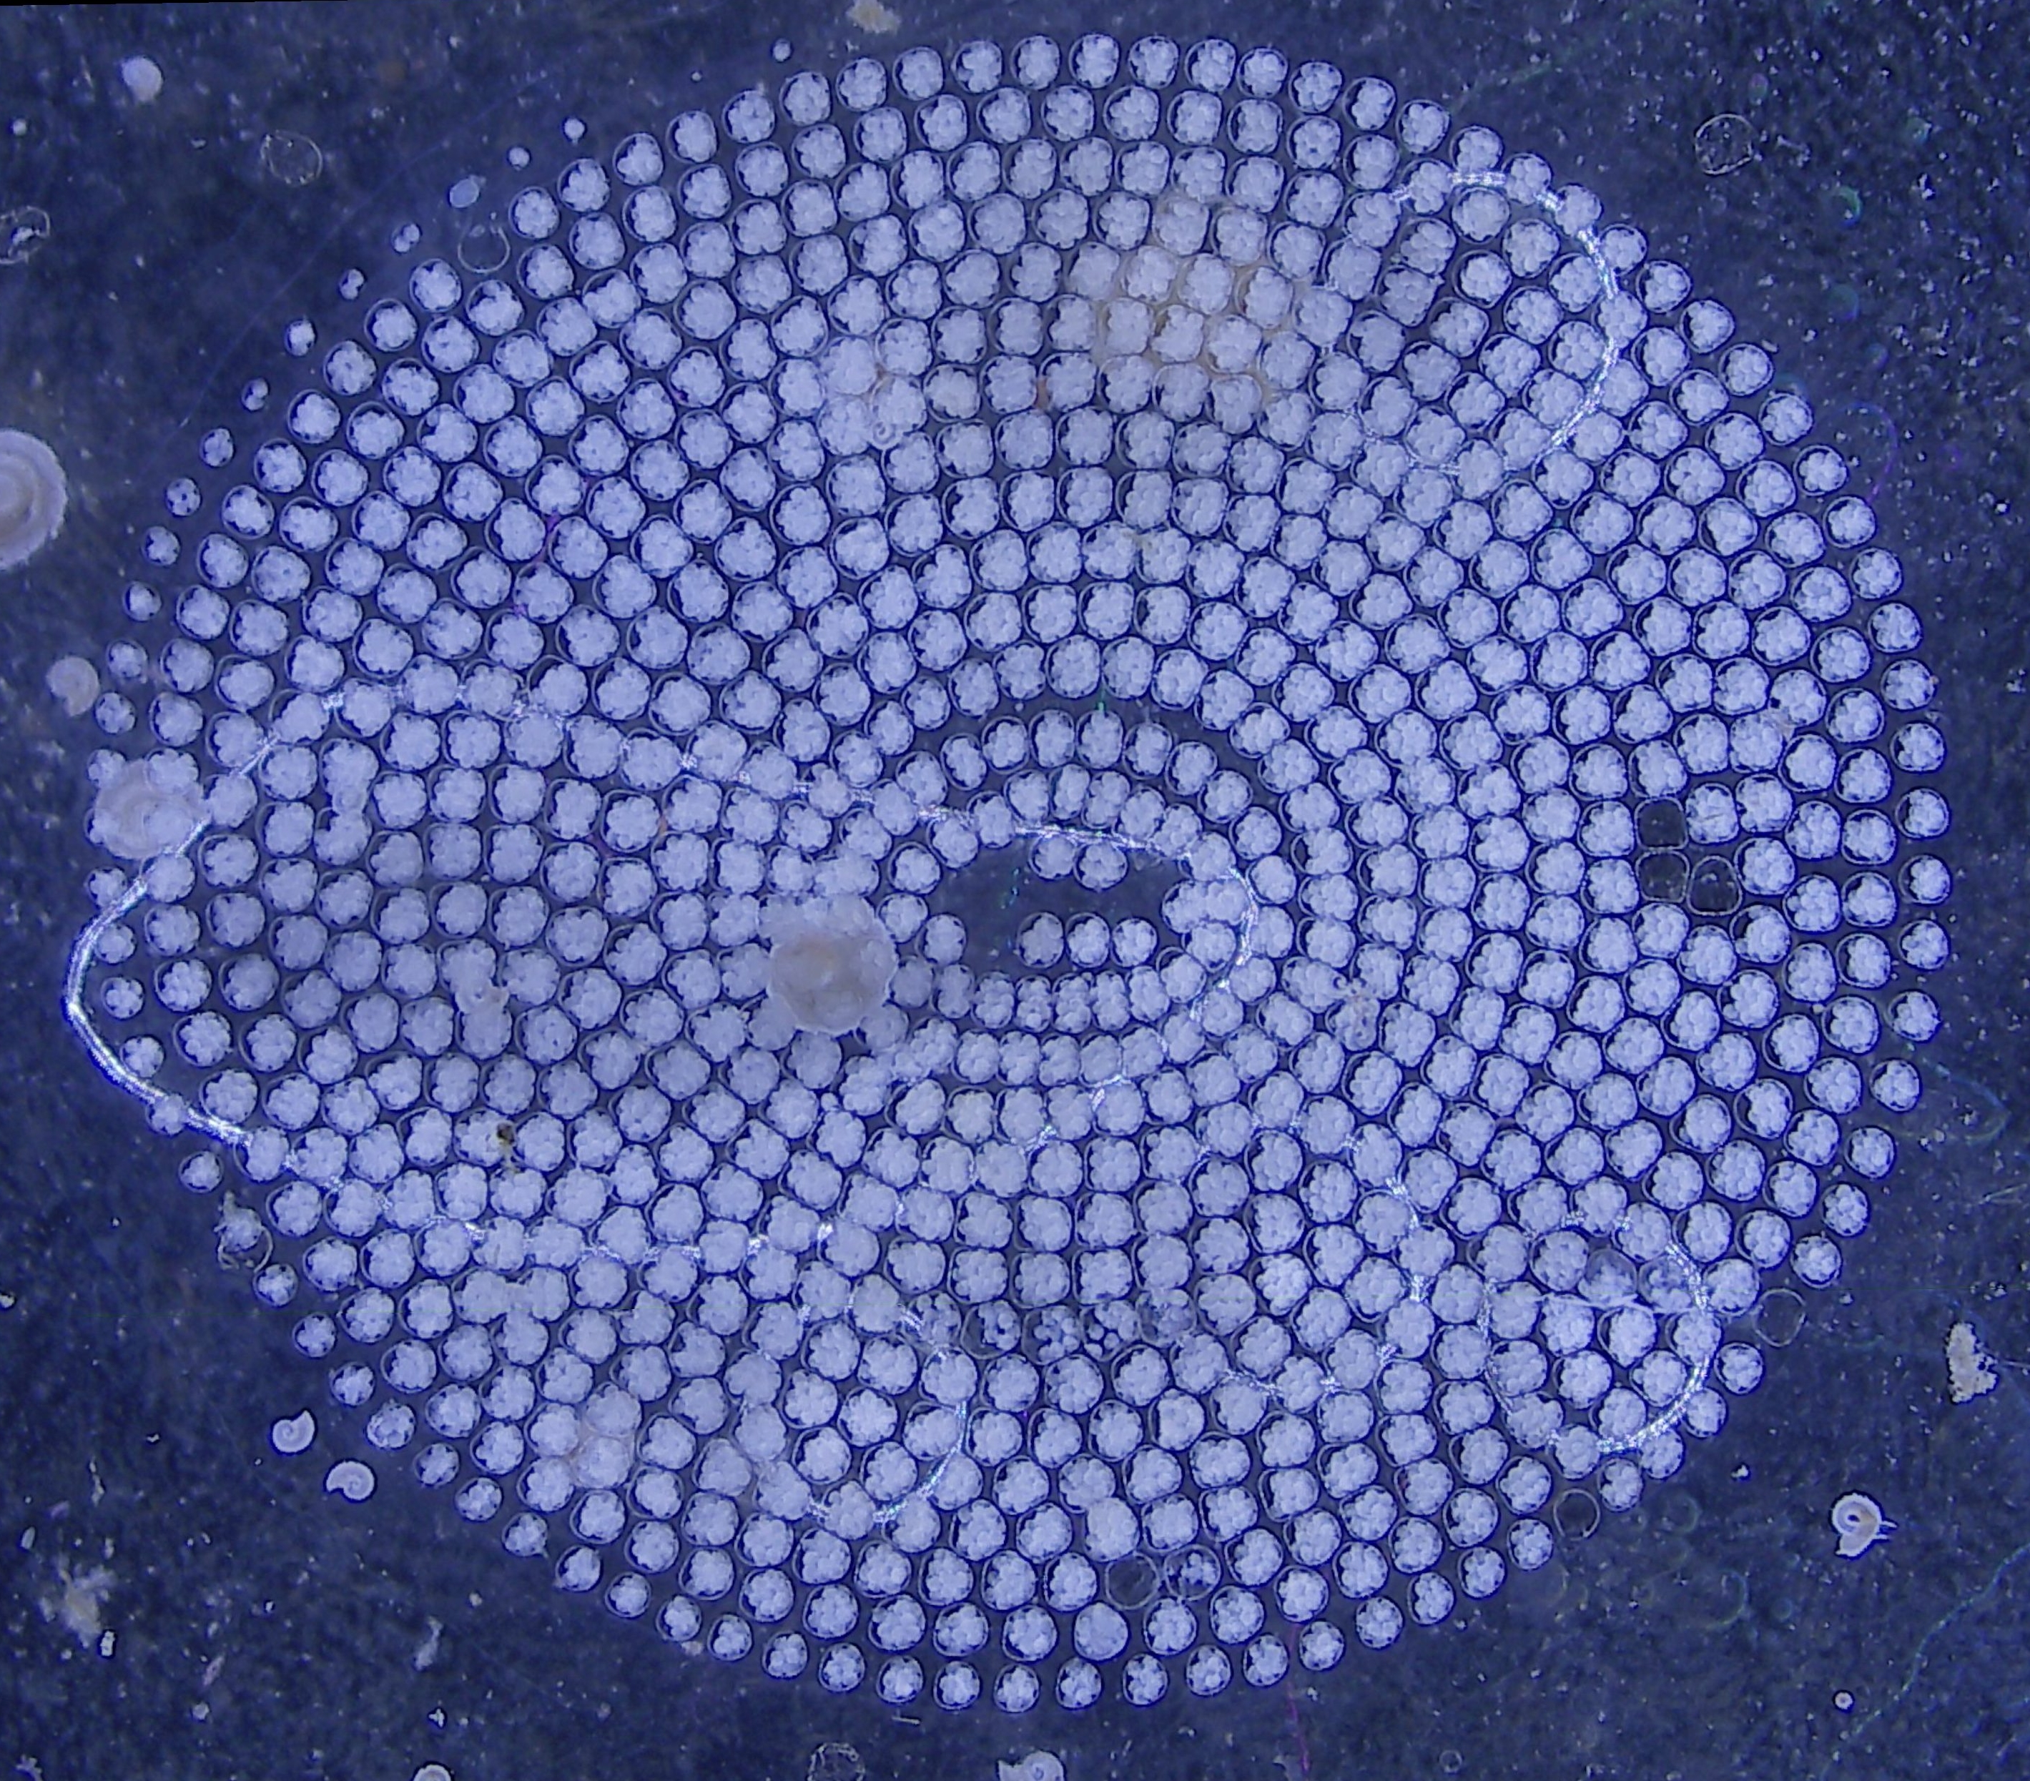
Field trips lead to unexpected discoveries

Slide 39
with Alexandra Kerbl, Ischia May 31, 2024

Slide 40
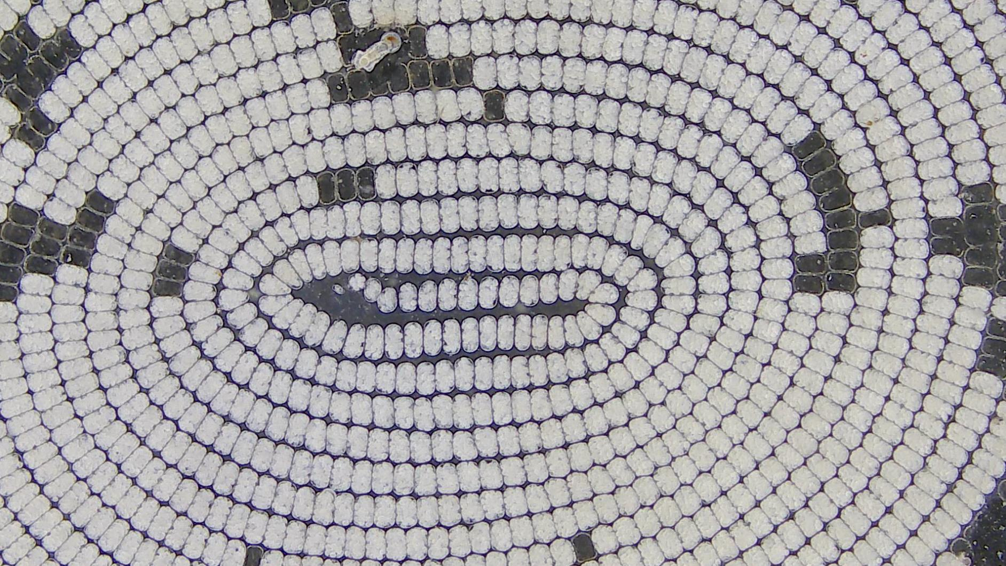
What is this?

Slide 41
with Alexandra Kerbl, Ischia May 31, 2024

Slide 43
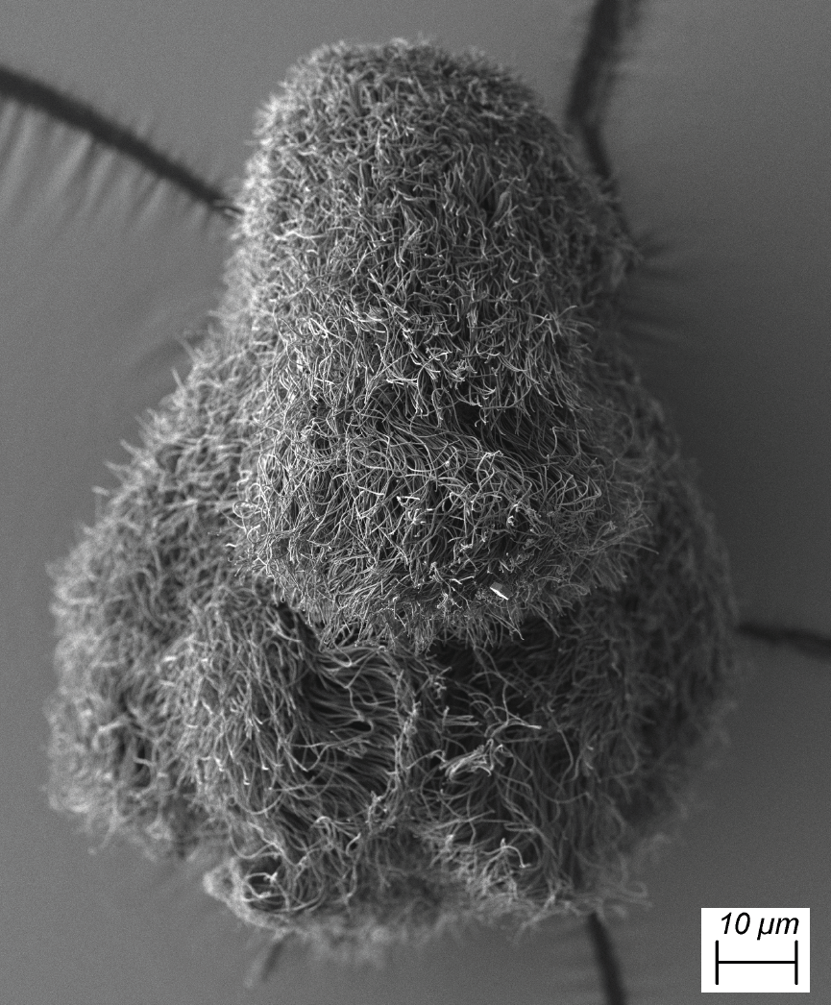
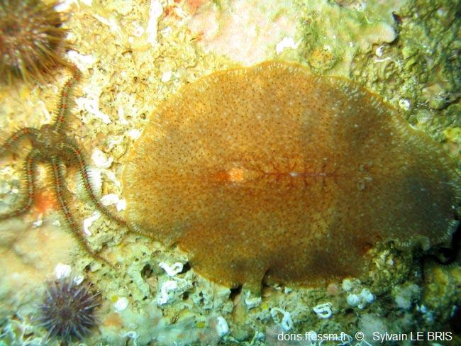
Egg plates and Müller’s larvae of polyclad flatworms

Slide 44
Karel Mocaer, Alexandra Kerbl

Slide 45
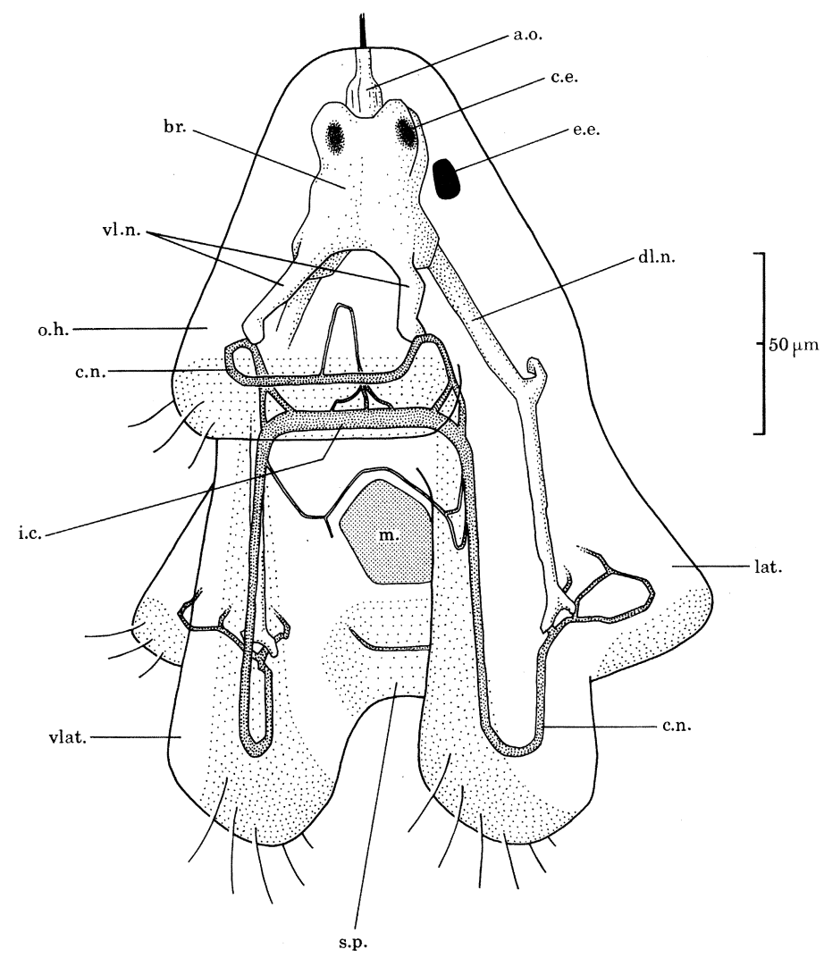
Müller’s larvae have a ciliomotor nervous system

Slide 46
Lacalli 1982

Slide 47
Ciliomotor system in Platynereis
24 ciliomotor neurons
2 Cholinergic Loop neurons

Slide 48
Verasztó et al. (2017)

Slide 49
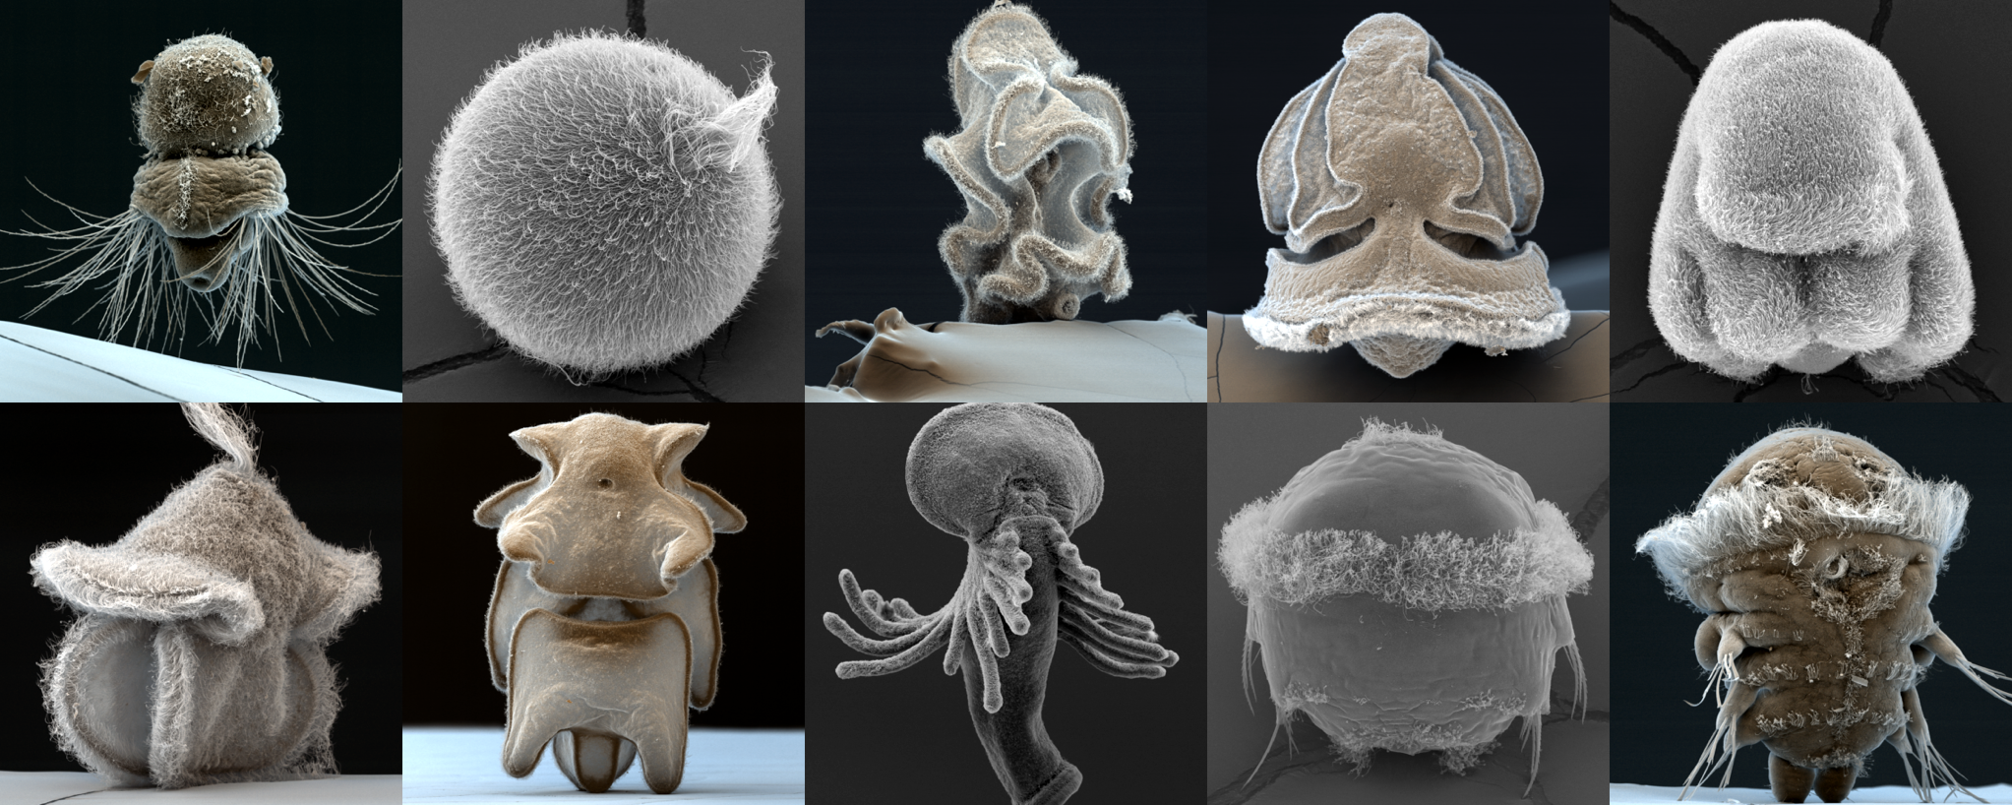
Comparative vEM & connectomics of marine larvae
12 labs (EU, UK)
vEM of marine invertebrates
evolution of cell types
integrate with molecular atlases

Slide 50
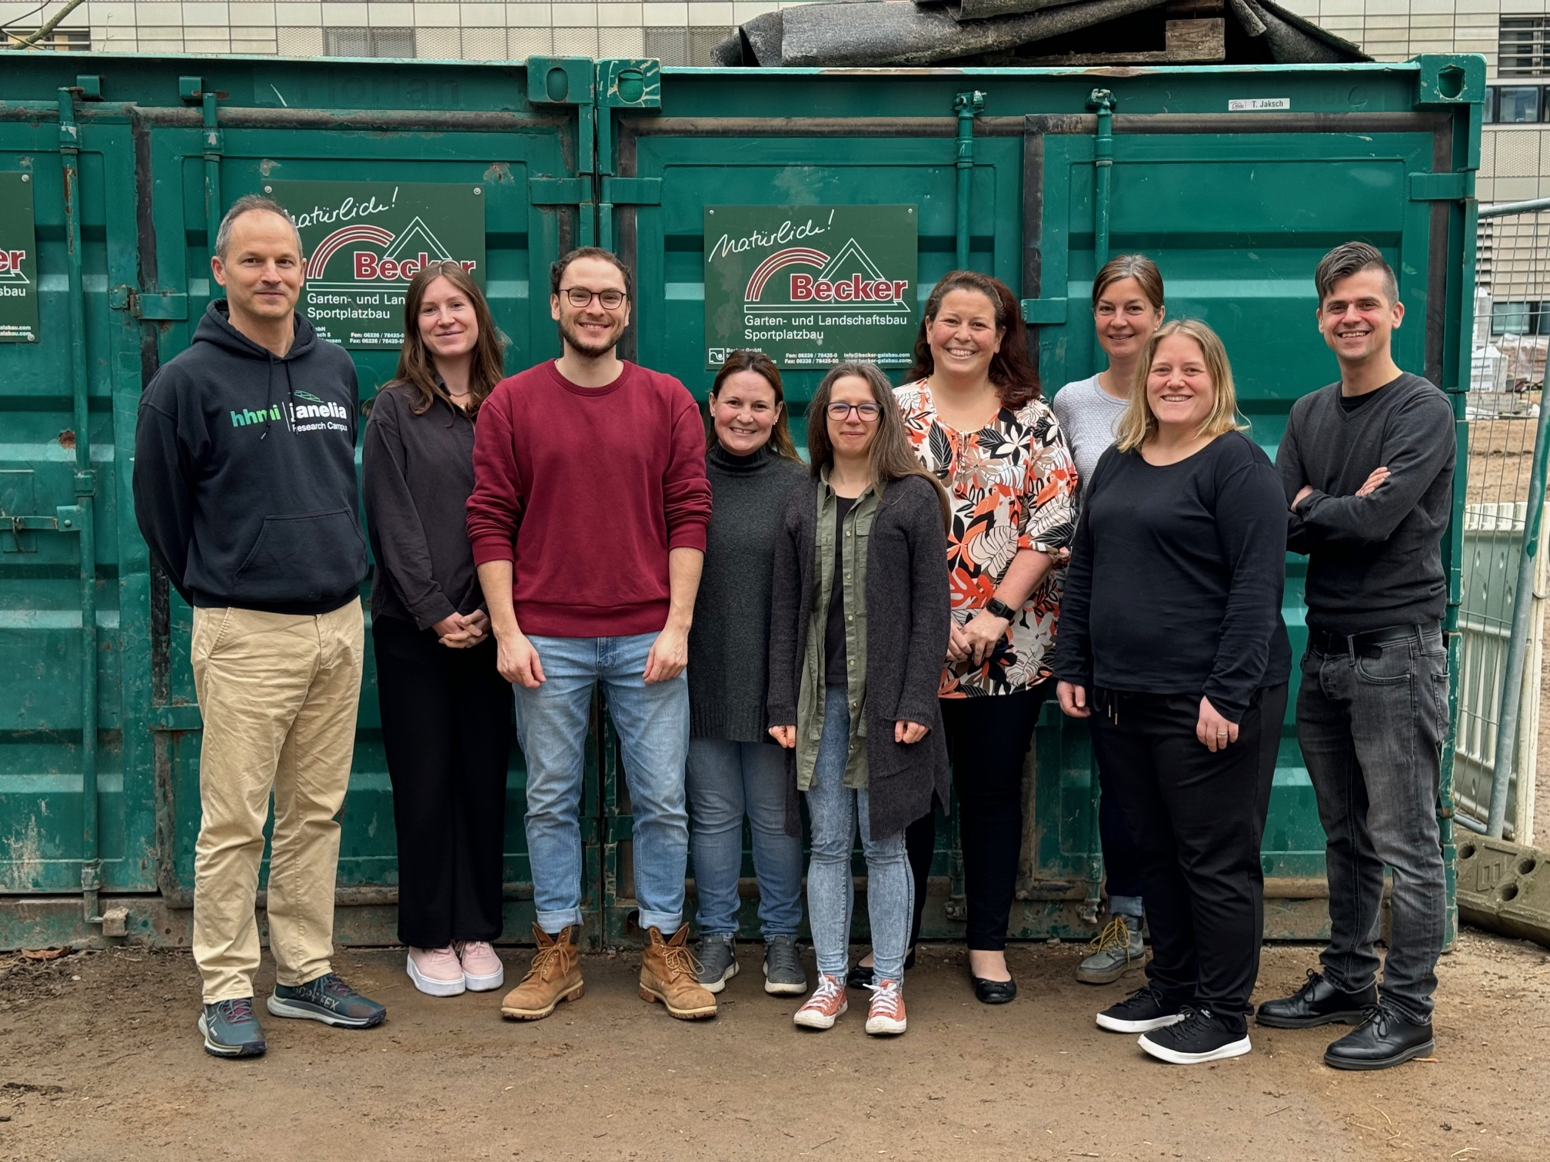
Acknowledgements
Sanja Jasek
Alexandra Kerbl
Emily Savage
Simone Wolters
Lara Keweloh
Kevin Urbansky
Karel Mocaer
David Hug
Benedikt Dürr
Ira Maegele
Emelie Brodrick (Exeter)

Slide 51


